Slide 1
Cloud infrastructure as .NET code using Pulumi
James Murphy - Programmer

Slide 2
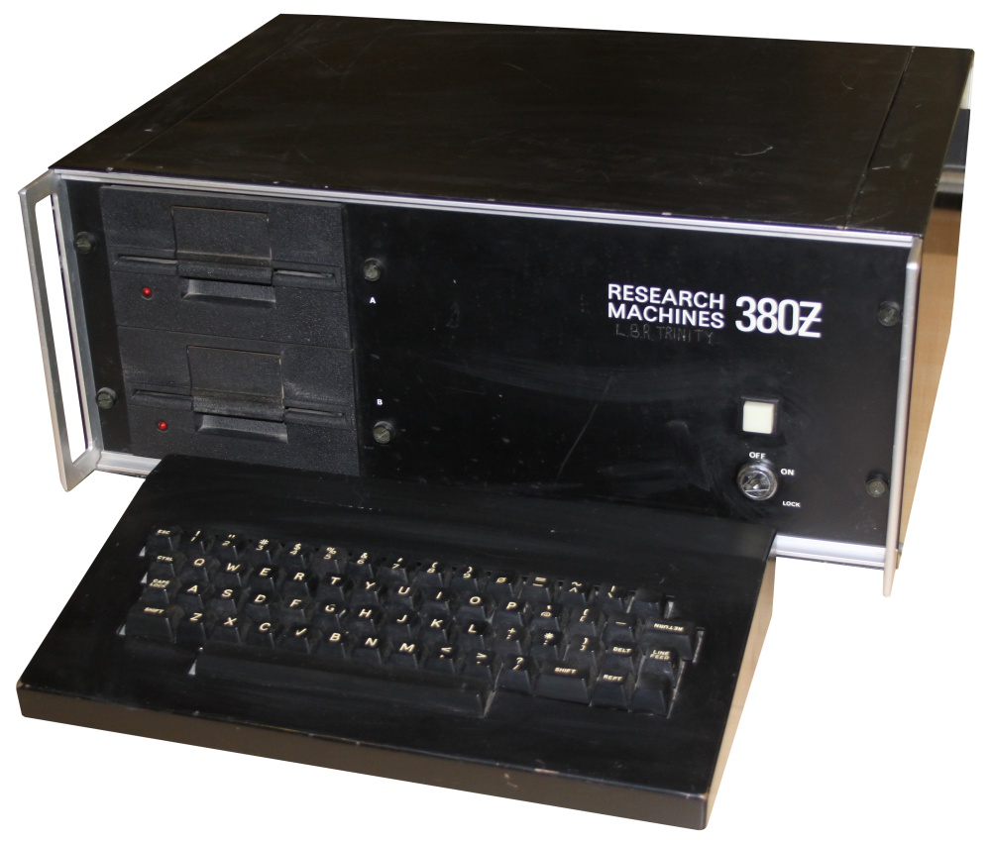

Slide 3


Slide 4
Questions
What is infrastructure as code?
Why is it a good idea?
If it is a good idea, why Pulumi?

Slide 5
What do we do?
Convert problems into cloud deployed solutions…

Slide 6

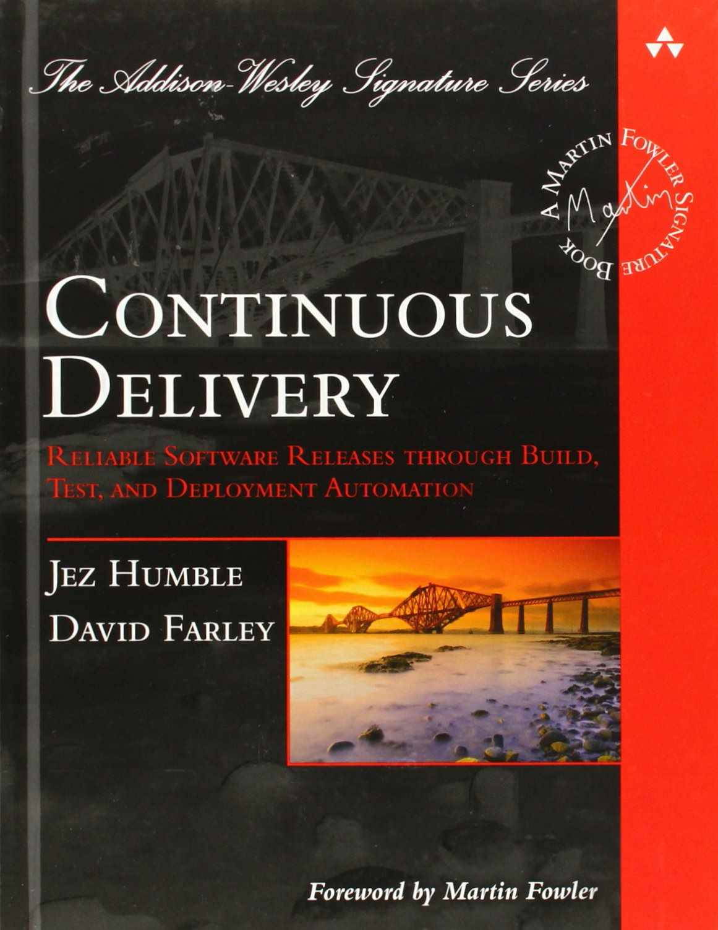
Learning from others
Notes:
What is infrastructure as code?
Why is it a good idea?
If it is a good idea, why Pulumi?

Slide 7
Automate! Everything!
Including deployment
Notes:
That we automate. Everything.
We automate things to make them trivially repeatable and that has to include deployment.
If you want to automate everything then using a cloud web console isn't the answer
So how do we automate definition of infrastructure or the definition of deployed systems (where there is considerable overlap).

Slide 8
Scripting…?
Notes:
There are a couple of approaches - we can "script" things - all of the cloud providers provide rest APIs and command line tools to create and configure services - unfortunately we want our definitions to be idempotent, we want to safely be able to run the script whether the services exist or not and that gets difficult quickly.

Slide 9

Desired State Configuration
Notes:
Better is to take the Picard approach, to define what our infrastructure should look like and then tell someone else to "Make it so" - this is "desired state configuration".
The good news is that the public cloud providers support this approach - they have declarative systems for specifying your requirements and engines that magically transforms those specifications into cloud infrastructure. The bad news is that we very quickly end up with a "wall of markup" - be that json or yaml

Slide 10
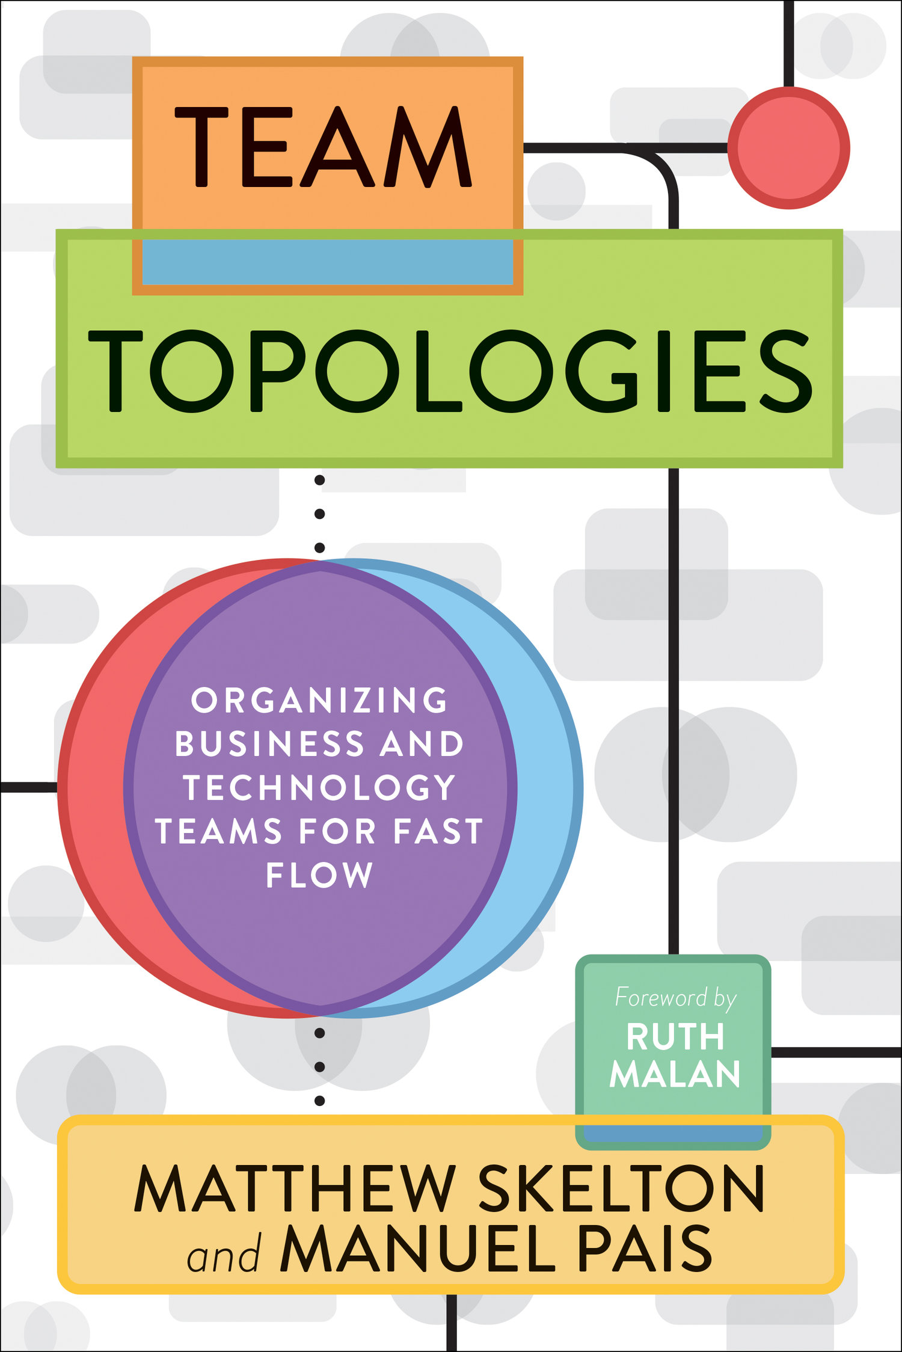

Cognitive Load
Notes:
Coming back to our core problem - delivering value by making deployed solutions available - there is a strong argument, outlined in the excellent Team Topologies, that delivery teams (5 to 9 people) should own solutions end to end, if you write it then you should deploy it and you should operate it.
A key limiting factor on what an individual and a team can own and operate is how much cognitive load it can support, what it can comfortably think about. Having to understand ARM or Cloudformation or the YAML for Google's Cloud Deployment Manager will consume a goodly chunk of that available load.
So we want something that is both more flexible than XML or YAML and that is more easily understood by the developers on a delivery team - in other words the same language we use to write applications – C# or F# code.

Slide 11
Code…
AWS - CDK (various languages)
Azure -Farmer, Bicep (maybe)
Pulumi
Multiple Services
Python, Go, Typescript, .NET
Notes:
- For AWS, amazon are providing the CDK
- For Azure there is the very impressive Farmer (its an F# DSL, I'm bound to like it...) and Microsoft are experimenting with Bicep
- Or there is Pulumi, which targets multiple services and which lets you write code in Python, Go, and in languages that support Node.js, and .NET. - and that means it probable that your team can define the system it wants to deploy using something it already understands and removes some of the additional load leaving more to think about the actual problem space rather than how to shave yaks.
The other advantage we gain from having infrastructure defined in text files (whatever the format) is that we can store that infrastructure with our application source code - that we can see it evolve and can audit it in the same way we do all our source code (and we can revert changes in much the same way)

Slide 12
Good things
Repeatable
Deploy to multiple environments
Deploy at whim
Version controlled
Notes:
At this point I think its clear that defining our infrastructure in a text file is a good thing
It makes deployment repeatable
It makes it possible to deploy to as many environments as we want
It makes it trivial to deploy as and when we want
We can use version control which gives us a history and the ability to audit and control what we do.

Slide 13
Pulumi
Language independence
Deployment management
Platform independence

Slide 14
Pulumi Providers

Slide 15
Show me the code…

Slide 16
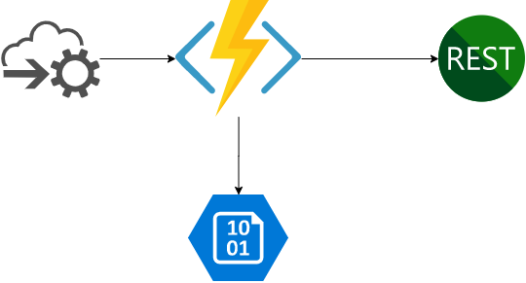

Slide 17
What have I missed?
Multiple stacks
Pulling outputs from one stack as inputs to another
Compiled stack code
Automated Testing
Automation API – run Pulumi from your code
Hooks into other services

Slide 18
Thank you!
Questions…?

